Slide 1


INVESTOR PRESENTATION

Slide 2
Disclaimer
This presentation contains historical and forward-looking statements. The forward-looking statements involve risks and uncertainties. Forward looking statements appearing in this presentation represent management’s current estimates and these may change significantly as new information comes to hand, including statements that relate to, among other things, revenue forecasts, technology development progress, plans for shipment using the Company’s next generation technology, production plans, the Company’s markets, objectives, goals, strategies, intentions, beliefs, expectations and estimates, using such words as “may”, “will”, “could”, “should”, “would”, “likely”, “expect”, “intend”, “estimate”, “anticipate”, “believe”, “plan”, “objective” and “continue” (or the negative thereof) and words and expressions of similar import.
Certain material factors or assumptions are applied in making forward-looking statements, and actual results may differ materially from those expressed or implied in such statements. Additional information about material factors that could cause actual results to differ materially from expectations and about material factors or assumptions applied in making forward- looking statements may be found in the Company’s most recent annual and interim Management’s Discussion and Analysis under “Risk and Uncertainties” as well as in other public disclosure documents filed with Canadian securities regulatory authorities. The information contained in this presentation has been obtained by TokenPlay from its own records and from other sources believed to be reliable, however no representation or warranty is made as to its accuracy or completeness .The Company does not undertake any obligation to update publicly or to revise any of the forward-looking statements contained in this document, whether as a result of new information, future events or otherwise, except as required by law.
2

Slide 3
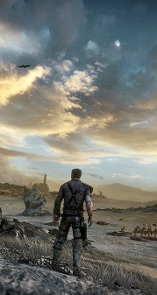
A Revolution Is Taking Place In The Digital Gaming Industry
Payment methods have not evolved together with technological advancements within the digital gaming industry. Transactions are expensive and inefficient.
Today, new games are being created that make use of digital items, such as cryptocurrencies. These items can be freely traded outside of the game on a public blockchain.
Effectively, a new decentralized token-based economy is in its inception.
46bn
USD spent on in-game assets in 2017
90bn USD
Industry
6% compound growth rate for in-game spending

Slide 4

TokenPlay Platform
At A Glance:
TokenPlay aims to position itself as the new payment platform of choice for the digital gaming industry
7% transaction fees vs. current market standard of ~30%
Exchange Platform for In-Game Tokens. Tokenplay will enable users to seamlessly exchange fiat currency with in-game tokens
Exchange Platform will enable peers to trade tokens between multiple games. In this way, Tokenplay will effectively provide the foundation for a new decentralized digital economy.
Through utilizing blockchain technologies we aim to deliver a decentralized platform which will solve the inefficiencies and expensive fees of conventional payment methods
Platform-as-a-Service video game app store

Slide 5
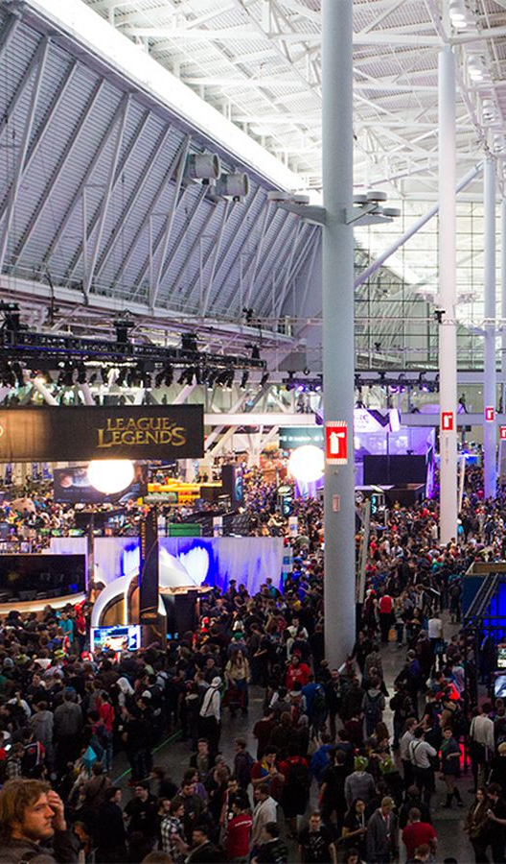
Gaming on the Blockchain: An Introduction
Welcome to the new real cash games economy, an economy which is open, borderless and decentralized.
The next generation of games
The revolution began on January 3, 2009, when the very first transaction block of the bitcoin blockchain, called the genesis block, was created by Satoshi Nakamoto.
Seven years after the creation of Blockchain, the first games taking advantage of this technology are beginning to emerge.
New games create and make use of digital items that are freely tradable on a public blockchain, outside of the game.
Games integrate cryptocurrencies in their own economy.
5
14

Slide 6
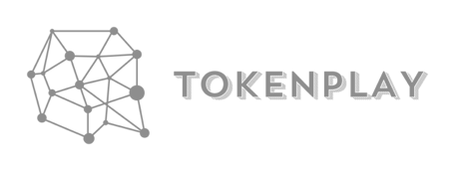

Tokenplay Advantage
CURRENT
Developer posts game onto a platform: Steam, Google, or iTunes
A gamer is prompted to link their credit card details to the game/payment system. Each time a purchase is made confirmation is required.
Steam/Google/iTunes appropriates up to 30% of each transaction
Developer posts game onto Tokenplay platform
A gamer is able to make payments with cryptocurrencies (“tokens”) from their digital wallet, or purchase in-game tokens directly with their credit card. These tokens can be used to purchase in-game character upgrades or items.
In turn, in-game items that the user earns by playing the game can be traded back to cryptocurrencies/fiat currency.
Tokenplay appropriates up to 7% of each transaction
The gamer is able to trade their tokens/cryptocurrencies and in-game items across all the different games on the platform.
125 million accounts
Most profitable company per employee in the U.S. 2011 (Newell)
Revenue estimated at 3.5billion in 2016
Cumbersome payment process during a gaming experience; not conducive to purchasing
Making a purchase in –game is a seamless and quick process,
30% of revenue in payment transaction costs
7%
of revenue in payment transaction costs
Not all countries have access to iTunes or GooglePay features
Accessible to anyone with wifi connection
Game developer has no way of verifying how many sales were made; lack of trust for Google/iTunes/
Steam
Complete transparency in all transactions due to blockchain technology.

Slide 7


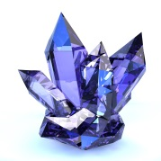
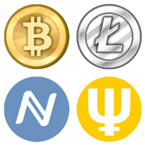

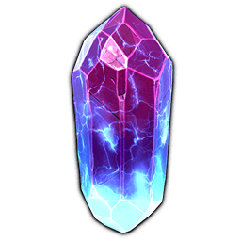
All games will be linkable and all games’ in-game credits can be exchanged with each other.
There will be a universal e-wallet available for the gamers and the platform will automatically detect the e-wallet once it is integrated into a publisher’s game.
Currently, gamers have no way of exchanging any kind of value outside of the game.
TOKENPLAY will enable trade between different games, thereby laying the framework for an entire economy where gamers can earn and trade items of real value
Game D
Game A
Game B
Game C
Cryptocurrency exchange or exchange for fiat currency
Once a gamer earns credits in-game, TOKENPLAY will enable them to trade these credits for real-world value: cryptocurrencies or fiat currency

Slide 8
Technology
7% per transaction
7% per transaction
Use Credit Card in-game to Purchase Tokens
Trade Tokens
Amongst Peers
In-Game Purchase
TokenPlay
Platform
Community
USER WALLET
Play and Retrieve to Wallet
Communicate with Gaming Community
Streamlined user experience
API’S
Exchange
SDK
MARKETPLACE
PEER 2 PEER TRADING
Sell Tokens
Purchase Tokens
Exchange Platform
7% per transaction

Slide 9
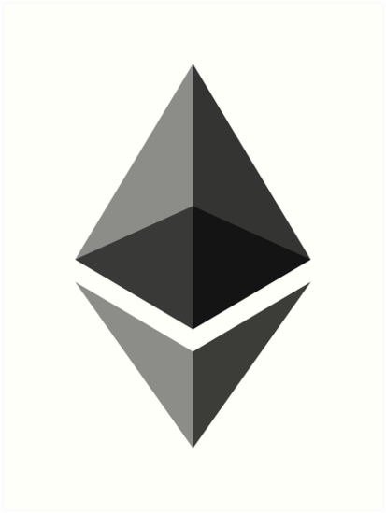
Technology: ETHERIUM Blockchain Platform
TokenPlay has chosen the ETHERIUM blockchain due to its distinguishing features:
API-call access to the blockchain via any blockchain node through the ERC20.
Solid development team, actively working on new technologies that will continue to improve stability, security, functionality, and scalability of the Ethereum Blockchain (e.g. Casper PoS)
Development team is currently working on the next token version called ERC223 (and they confirm that it will be upgradeable from ERC20)
Easy migration from ERC20 to any of the latest blockchain technologies to hit the market in the near future, such as EOS, AION or TESOS.

Slide 10


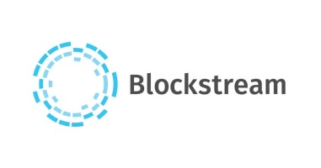



TokenPlay Potential and Use Cases
TokenPlay – Built on ERC20
Use Cases – ICOs
Etherium-2014- $18,439,086
Blockchain technology – LATEST TECH ON THE MARKET
Bancor Protocol – June 2017 – $152,000,000
Token on ERC20
Banking Services (TECH IN DEVELOPMENT)
Aeternity – June 2017 – $62,500,000
Token on ERC20
Blockhain protocol (TECH IN DEVELOPMENT)
EOS – June 2017 – $185,000,000
Token on ERC20
Blockchain Protocol (TECH IN DEVELOPMENT)
Polkadot – October 2017 – $150,000,000
Token on ERC20
Multiblockchain Protocol (TECH IN DEVELOPMENT)
Tezos – July 2017 – $232,000,000
Token on ERC20
Latest Blockchain Technology (TECH IN DEVELOPMENT)
Filecoin – September 2017 – $257,000,000
Token on ERC20
Data storage via blockchain (TECH IN DEVELOPMENT)
Toronto-based blockchain solutions for enterprises
$27,000,000 USD ICO
Seed from Bessemer Ventures, XDL Capital, Plug and Play
Vancouver-based company with proprietary blockchain platform that enables smart contracts
$71.3 million market cap
$3.75 USD/share
$43.7m in equity funding
(500 Startup, Betaworks, Blockchain Capital, BoxGroup, Capital One Growth Ventures, Citi Ventures, Digital Currency Group, Draft Ventures, Fiserv, Homebrew, Kevin Ryan, Khosla Ventures, NASDAQ, Orange, Orange Digital Ventures, Pantera Capital, RRE Ventures, Scott Banister, Semil Shah, Thrive Capital, Visa)
$76m in equity funding
(Acecap, AME Cloud Ventures, AngelList, AXA Strategic Ventures, Blockchain Capital, Daniel Curran, Danny Hillis, Data Collective, Digital Garage, Embrase, Flight Ventures, Horizons Ventures, Innovation Endeavors, Khosla Ventures, Mosaic Ventures, Real Ventures, Reid Hoffman, Ribbit Capital, SK Ventures)
$90m in equity funding
(Bill Tai, Binary Financial, Blockchain Capital, Bob Dykes, Credit China FinTech Holdings, DRW Venture Capital, Georgian Co-Investment Fund, iTech Capital, Jonathan Teo, Lars Rasmussen, QueensBridge Venture Partners, ZAD Investments)
$39m in equity funding
(Deloitte)

Slide 11

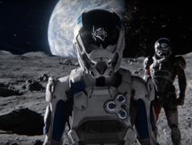
Summary: TokenPlay Advantages
The next generation of games
Allows game publishers to maintain their own in-game credits.
Offers a web-platform exchange, purchase and transfer the in-game credits, accessible from the Desktop, Mobile, and In-game browser window.
Facilitates the buying of in-game credits and in-game products, enabling users to purchase outside of the game as well.
Supports game publishers to create an ecosystem of spending and earning by paying through a two-way exchangeability model.
Game publishers do not need to rely on Google / Apple in-app payment solutions any more.
The currency can also be purchased on designated exchanges or purchased directly from the “New Co.” platform itself.
Users must purchase currency in order to acquire in-game power-ups for upgrading their games' characters.
Accumulated in-game power-ups can be exchanged for currency as well.
There will be a universal e-wallet available for the gamers and the platform will automatically detect the e-wallet once it is integrated into a publisher’s game.
All games will be linkable and all games’ in-game credits can be exchanged with each other.
Each user has an account of different currencies.
16

Slide 12
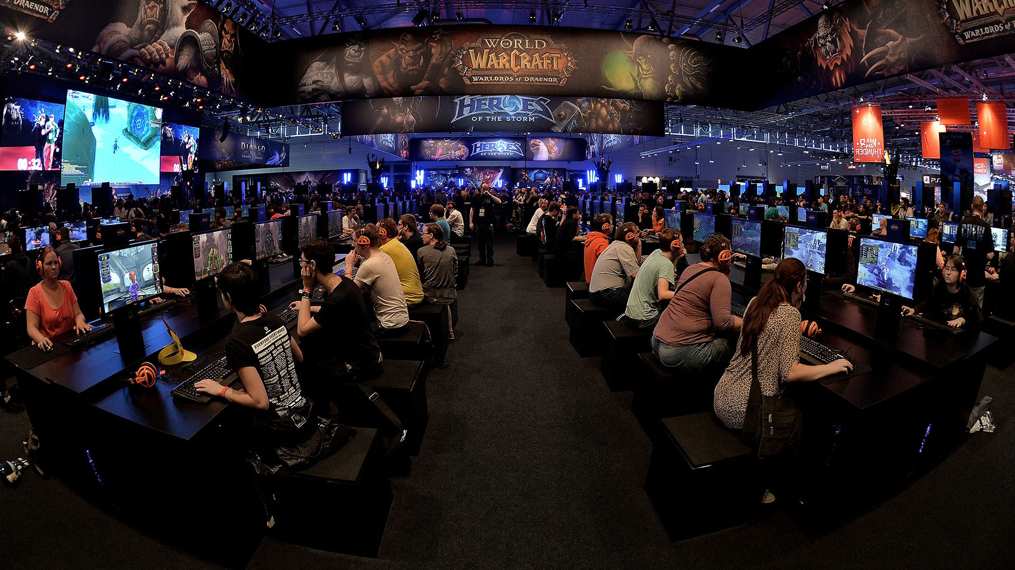
TOKENPLAY IS THE FIRST TO MARKET BLOCKCHAIN-ENABLED PAYMENT PLATFORM FOR THE GAMING INDUSTRY
TokenPlay has low risk margins, as it will be anchored transnationally and wedded innovatively with the foundational blockchain technology, that is on the road to transforming the economy and society of the future.
Tokenplay provides game developers w/t APIs and SDKs that allow the payment system to be integrated into virtually any game
Game development community highly interconnected, news of a new attractive payment structure and transparency will travel fast
Strategic partnership in China to capture marketshare

Slide 13
Sales Projections – 5 Year Performance (USD)
 | 2018 | 2019 | 2020 | 2021 | 2022 | Total 5 year
Revenue Generated | $3,023,446 | $7,334,523 | $12,455,763 | $17,345,459 | $24,856,477 | $65,015,668
Revenue for TokenPlay 30% | $907,034 | $2,200,357 | $3,736,729 | $5,203,638 | $7,456,943 | $19,504,700
Operating Expenses | $604,689 | $786,096 | $864,706 | $907,941 | $953,338 | $4,116,769
IT Development Cost | $657,646 | $920,704 | $1,288,986 | $1,804,581 | $2,526,413 | $7,198,330
Net Income (USD) | -$355,301 | $493,557 | $1,583,037 | $2,491,116 | $3,977,192 | $8,189,601
The growth outlined in the proforma is based on a less than 1% fraction of total gaming revenues. The sales category are numbers based on the lowest market share (and with the “official credo” of online gaming of 1% market share being the minimum target, we can talk about potentially higher turnover expectations). * Additional revenue shall be introduced through advertising modules.

Slide 14

Investment Opportunity
Seeking US $3,500,000 in equity
Planned Use of Funds
Regional Offices |  | $65,000
Marketing & Advertising |  | $550,000
OPEX |  | ~$800,000
Programming & Development |  | $1,602,000
Licensing Fees |  | $200,000
Total Operating Funds Required |  | $3,500,000

Slide 15
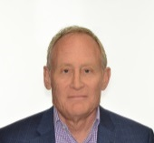






The Team
Board Members
Advisors
Rob Howe
Director
Steven Hoffmann
Director
Lone Mountain Media Strategic & Token
Economics
Byron Berry, CFA, MA, BA
Advisor
Robert is a seasoned international financial services executive with over 25 years of senior level management experience shared between the asset finance sector and corporate turnaround and growth consulting. He spent most of his corporate career with AT&T Capital/ Newcourt Credit Group/CIT and was Managing Director of its Continental European business, which supported 150 staff in 16 countries with owned and managed assets exceeding $1 billion. In 2006, Robert founded Aorta Capital, a Switzerland-based early stage investor, capital raising and consulting boutique.
Founder and Director of Bridgemark Advisors Ltd., a boutique advisory firm with operations in Canada and London, UK. Entrepreneurial experience includes being the founder of Renewable Energy, CoGen, Encryption and Energy Storage companies (Private, Public). Private to Public transaction experience in Europe, AIM, OTCQX, TSX.V, CSE, and Hong Kong.
Currently holding roles as CFO, BOD, and Strategic Advisor for Telecom, IOT Security and Energy Storage Technology. A.S in Engineering B.A. in Business Administration from Boston, USA,
Lone Mountain Media (LMM) is advising clients and partners on media acquisition and distribution strategies, financial structures, and strategic positioning of products and brands. LMM’s principal executives have specific expertise in the areas of visual culture and financial strategies. Their ventures in film and media give them the upper hand to discover and recognize marketing campaigns with a strong appeal to clients and the general public, and their strong understanding and knowledge of token economics will provide any team the necessary advantage when working with blockchain.
Byron is CEO and founder of Coreventus, a research firm focused on blockchain technologies. Byron has over 20 years of entrepreneurial experience in finance and technology. Starting with Scotia Capital in 1993, he has been a research analyst, entrepreneur and investment banker. In 1995, he was the founding technology analyst at Yorkton Securities. He was co-founder and president of Thinksmith, a leading team collaboration software company, and a #1-ranked technology research analyst, while at National Bank Financial. Following this he was a #1 ranked research analyst in Income Trusts, an innovative asset class with over $250 billion in market capitalization at Dundee Securities. Since 2007 Byron has raised capital for, advised and invested in numerous technology companies across North America as a merchant banker with Traverse Capital and DVDT Partners.
Byron has also served on the boards of several private companies and not-for-profit organizations, and has a member of the Strategic Advisory Board for Leitch Technology Corp, a TSX 300 technology company.
Technology Team
Tech Advisors Team
Tsolmondorj Natsagdorj
Chief Blockchain Officer
Vlatko Gigov
CTO
Benn Godenzi
Blockchain Gaming Specialist
Tsoma is a developer, experienced cryptocurrency trader and an analyst of the emerging crypto-economics space. Tsoma is among the early investors in Bitcoin, starting in 2011. Tsoma founded a think tank which connects industries and governments to form “Startup Societies.” He is currently an advisor to Nonpariel Capital and developer for trive.news – which has an aim to kill fake news with the power of the crowd. Tsoma is also passionate about introducing youth to the new emerging economic paradigms early on so that they can be the authors of their own financial future.
Expert in blockchain ecosystems, token economics, new technologies and telecomunications. Formerly Officer for Economic affairs at a Permanent Mission to UNOG. Worked as a project leader in charge of organizational structure, teams, and processes at Sovereign Solutions, developing frameworks for Digital Services and Telecommunications for rural markets. Holds two MBAs with a Major in Global Banking and Finance, and a Major in Human Resource Management. Possesses strong Financial skills such as negotiations and budget planning.
Currently the Marketing Director for aion.network a breakthrough blockhain technology out of Toronto, Canada, Mr. Godenzi is one of the few marketing professionals that utilizes digital media campaigns to target blockchain aficionados. He is the owner and founder of Outlast Nutrition, an open source fitness community where athletes of all levels come together to share their knowledge. He also serves a marketing role for Skrilla which is an esports wagering platform, commencing its ICO on November 6th, 2017.

Slide 16




The Team
Administration and Finance
Marketing & Communications
Tech Advisors Team
Konstantin Lichtenwald
Chief Financial Officer
Monica Kwias
Marketing Director
Valerie Raigorodskaia
Communications & IR Director
A marketing veteran with more than a decade of experience working with top-tier B2B and consumer technology brands, Monica Kwias brings strategic insight and innovation to integrated marketing programs.
Founder and CEO of MMK Marketing, whose current and past clients include Intel, Google, Microsoft and Toshiba. Experienced in global and North American business and consumer marketing: mass media planning and buying, digital demand generation, social media, retail, promotions events, global sponsorship programs, and global branding.
Valerie has extensive experience providing Marketing, Branding & Communications support to numerous international projects in various fields. After graduating with Honors from the Zicklin School of Business at the City University of New York with a Bachelor in Marketing Management and Advertising, she has spent a few years in New York City. Solid experience in creative direction and conception, brand identity, website content management, traffic analytics, digital and social media marketing, SEO, market research, content marketing, project management, and investor relations. Masters in International Business Development from the University of Neuchatel, Switzerland.
Mr. Lichtenwald has over ten years of finance and accounting experience, including corporate compliance, accounting and financial management. His accounting, financial skills offer a multi-faceted hands on approach to strategic management and problem solving.
Mr. Lichtenwald specializes in providing corporate finance, valuation, taxation, financial reporting, consulting and other accounting services to public companies. Mr. Lichtenwald also assists in many aspects of clients’ administration, financing and other activities.
Mr. Lichtenwald holds the professional designation of (CPA, CGA) and (ACCA), where he is a member of Chartered Professional Accountants of B.C. and Canada as well as a member of the Association of Chartered Certified Accountants of United Kingdom. Mr. Lichtenwald has had extensive experience as a controller and CFO of numerous publicly traded and private corporations in several industries.
Nayan Williams
Chief Gaming Officer
Leona Hobbs
Digital Marketing
Nayan has the ability to mix big picture thinking with instinctively being on trend with the projects he works on, including music and gaming endeavors. He has worked on top grossing mobile games like Shrek, Smurfvillage, and Kim Kardashian with companies like Capcom, Digital Extremes and GLU mobile.
His music industry experience reaches to the foreign market, in France, where he worked with multi-platinum French artists as an Executive Producer. His value lies in brining in the right people, providing the right guidance to make his projects fit the market, and hitting the requierd results.
Leona Hobbs is a seasoned leader and gifted marketing strategist. Focused on digital, Leona develops performance marketing programs and leads teams to success. Over her 20-year career, she has consulted with technology companies across North America and worked for internet companies such as Yahoo and Tucows.

Slide 17

CONTACT
STEVEN HOFFMANN
email: sh@bridgemark-advisors.com
phone: 1.647.986.5355
First Canadian Place
100 King Street West, Suite 5700
Toronto, ON M5X 1C7
Bridgemark
Bleicherweg 14
Zurich 8002
Tel: +41 79 952 8443
Email: sh@navcapital.ch

Slide 18
Bridgemark
Bleicherweg 14
Zurich 8002
Tel: +41 79 952 8443
Email: sh@navcapital.ch
APPENDIX

Slide 19
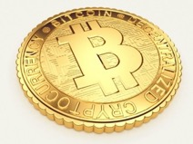
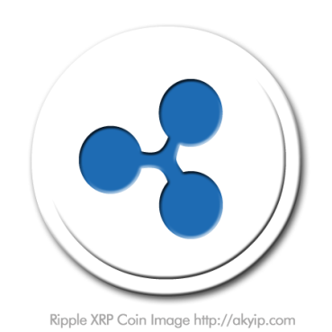
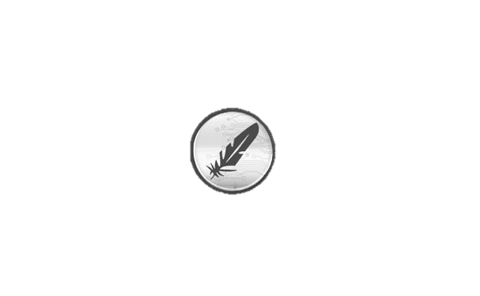

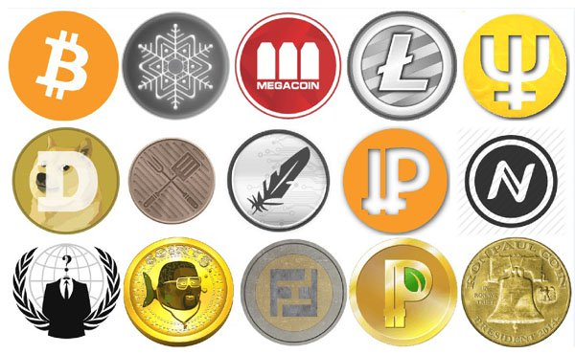
Revenue Model
TokenPlay earns its revenue by charging game publishers for publishing their games on the TokenPlay platform, which thus enables them to earn money through the use of cryptocurrencies.
TokenPlay revenue stream will come from the following:
(1.) Game Charge:
After signing up, there is an issuance of a game publisher’s in-game credits.
(2.) Banner Advertising:
Banner advertisements on the TokenPlay platform.
(3.) Viewing game advertisement videos to unlock The Currency:
In order to obtain extra in-game credits, TokenPlay users have to watch an advertisement for a set number of seconds of a particular game and then they will get whatever amount we decide on of in-game credits of that particular game.

Slide 20

Proposed Roadmap
Developed White Paper
A finalized White Paper has been developed for utilization of technology implementation into the company platform under the TokenPlay brand for public release.
Team Integration
TokenPlay Team includes public company experience in the fields below, which shall be announced and assigned to TokenPlay to support Blockchain technology in the gaming space :
Communications Specialist with expertise in the gaming / technology sector
Gaming Specialist in mobile with an established track record
Board of Directors Member from Bridgemark
COO/CFO for support and heading ”New Tech” in Blockchain
Blockchain Development Director
CTO – Blockchain and Development
Developers - Technical programming
Platform Development
for Technology, paid in common shares in TokenPlay,
for utilization for its gaming audience at STAGE 1 of
integration of Blockchain technology for the gaming
industry.
Technology and Platform Marketing Roll-Out
specifically for the final developed technology of
Blockchain, implementable for TokenPlay gaming
Space. This can include integration of Blockchain,
Digital Currency Acceptance and/or integration of
Online betting.

Slide 21
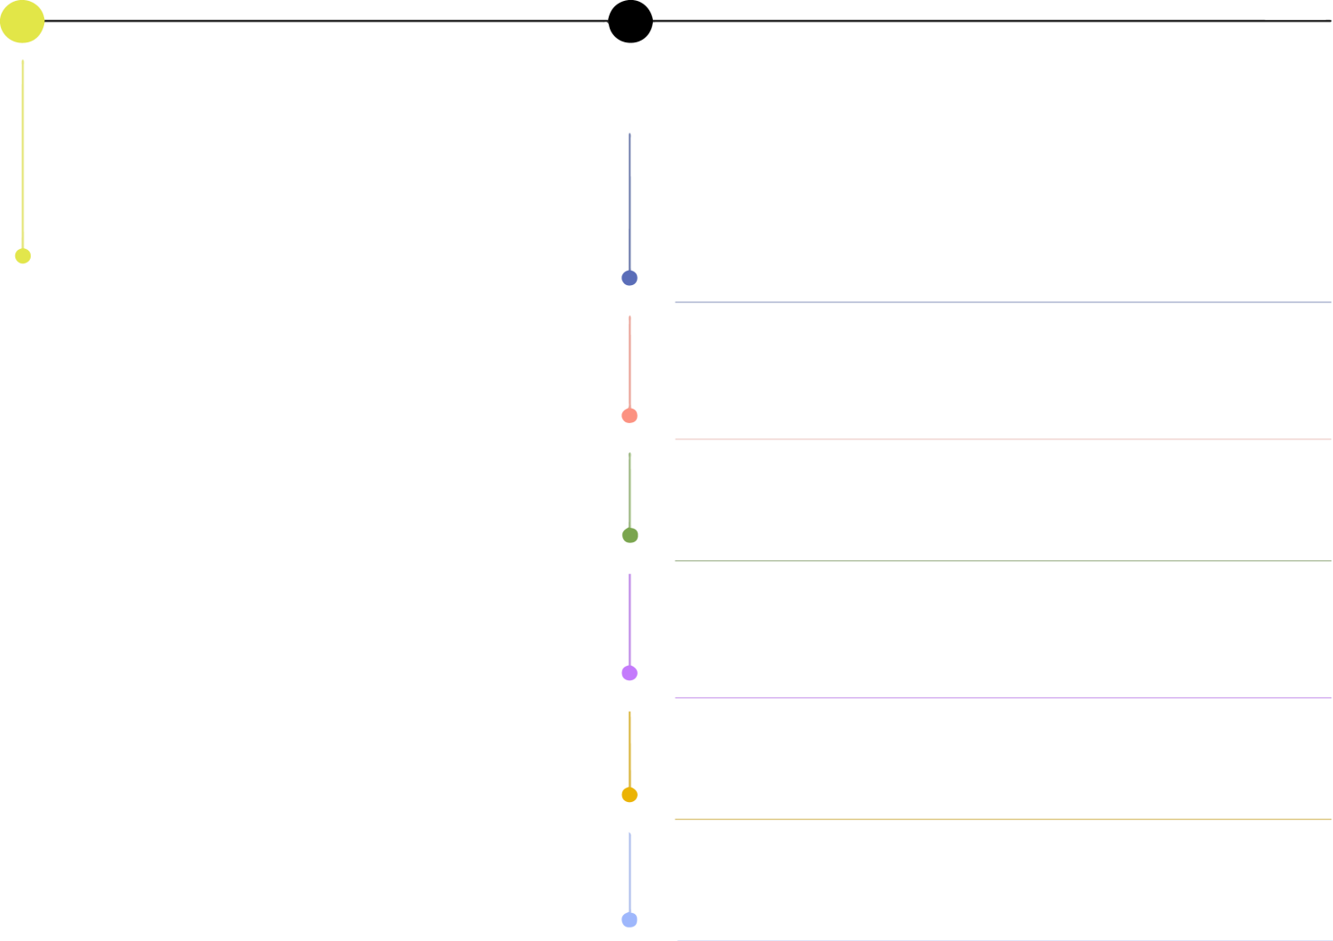


Development Timeline
2017
2018
The roadmap below is divided into 6 stages. Each stage represents an advancement in platform technology, licensing and partnerships in order to grow the ecosystem, and the token’s utility within it, for the benefit of members.
^{Q4}
^{Current Position}
^{-Whitepaper ready}
-Peer review of whitepaper - 14 days
- Ecosystem validation within the community – in parallel
-Token Technology Development on ERC20 – 90 days
- Beta testing within controlled environment
- API Markeplace development – 60 days
- Payment Gateway validation - 15 days
- TokenPlay exchange platform development – 60 days
^{Q1}
^{Stage 1}
^{- TokenPlay wallet integration}
- Digital Marketing Campaign for Token Sales – to commence 60 days prior to pre-sales while developing the Utility Token
- Sponsoring gaming tournaments to spread the word
^{Stage 2}
^{- TKY integration}
^{- API Marketplace integration}
- Licencing of TokenPlay technology to third parties (gaming companies)
^{- Token Contests}
^{Q2}
^{Stage 3}
- Regional Expansion through geographic segmentation
- Platform transition to latest or proprietary blockchain
^{Stage 4}
- Worldwide tournaments generation on all game types and platforms – prizes in TKY
- Scale of instant fiat to TKY conversion: 1. In game conversion 2. Exchange platform conversion
^{Q3}
^{Stage 5}
- Integration of live betting on gaming tournaments
- Social betting function as an interactive offering
^{Q4}
^{Stage 6}
- Create strategic partnership for in-games and exchange payment processes with major game producing companies

Slide 22
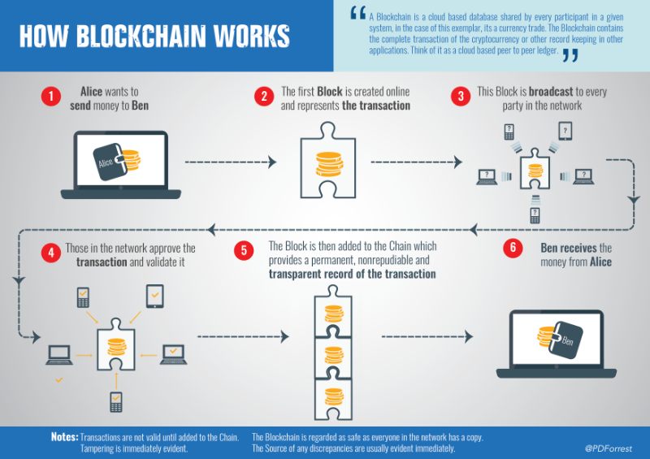
Blockchain Technology Principles

Slide 23

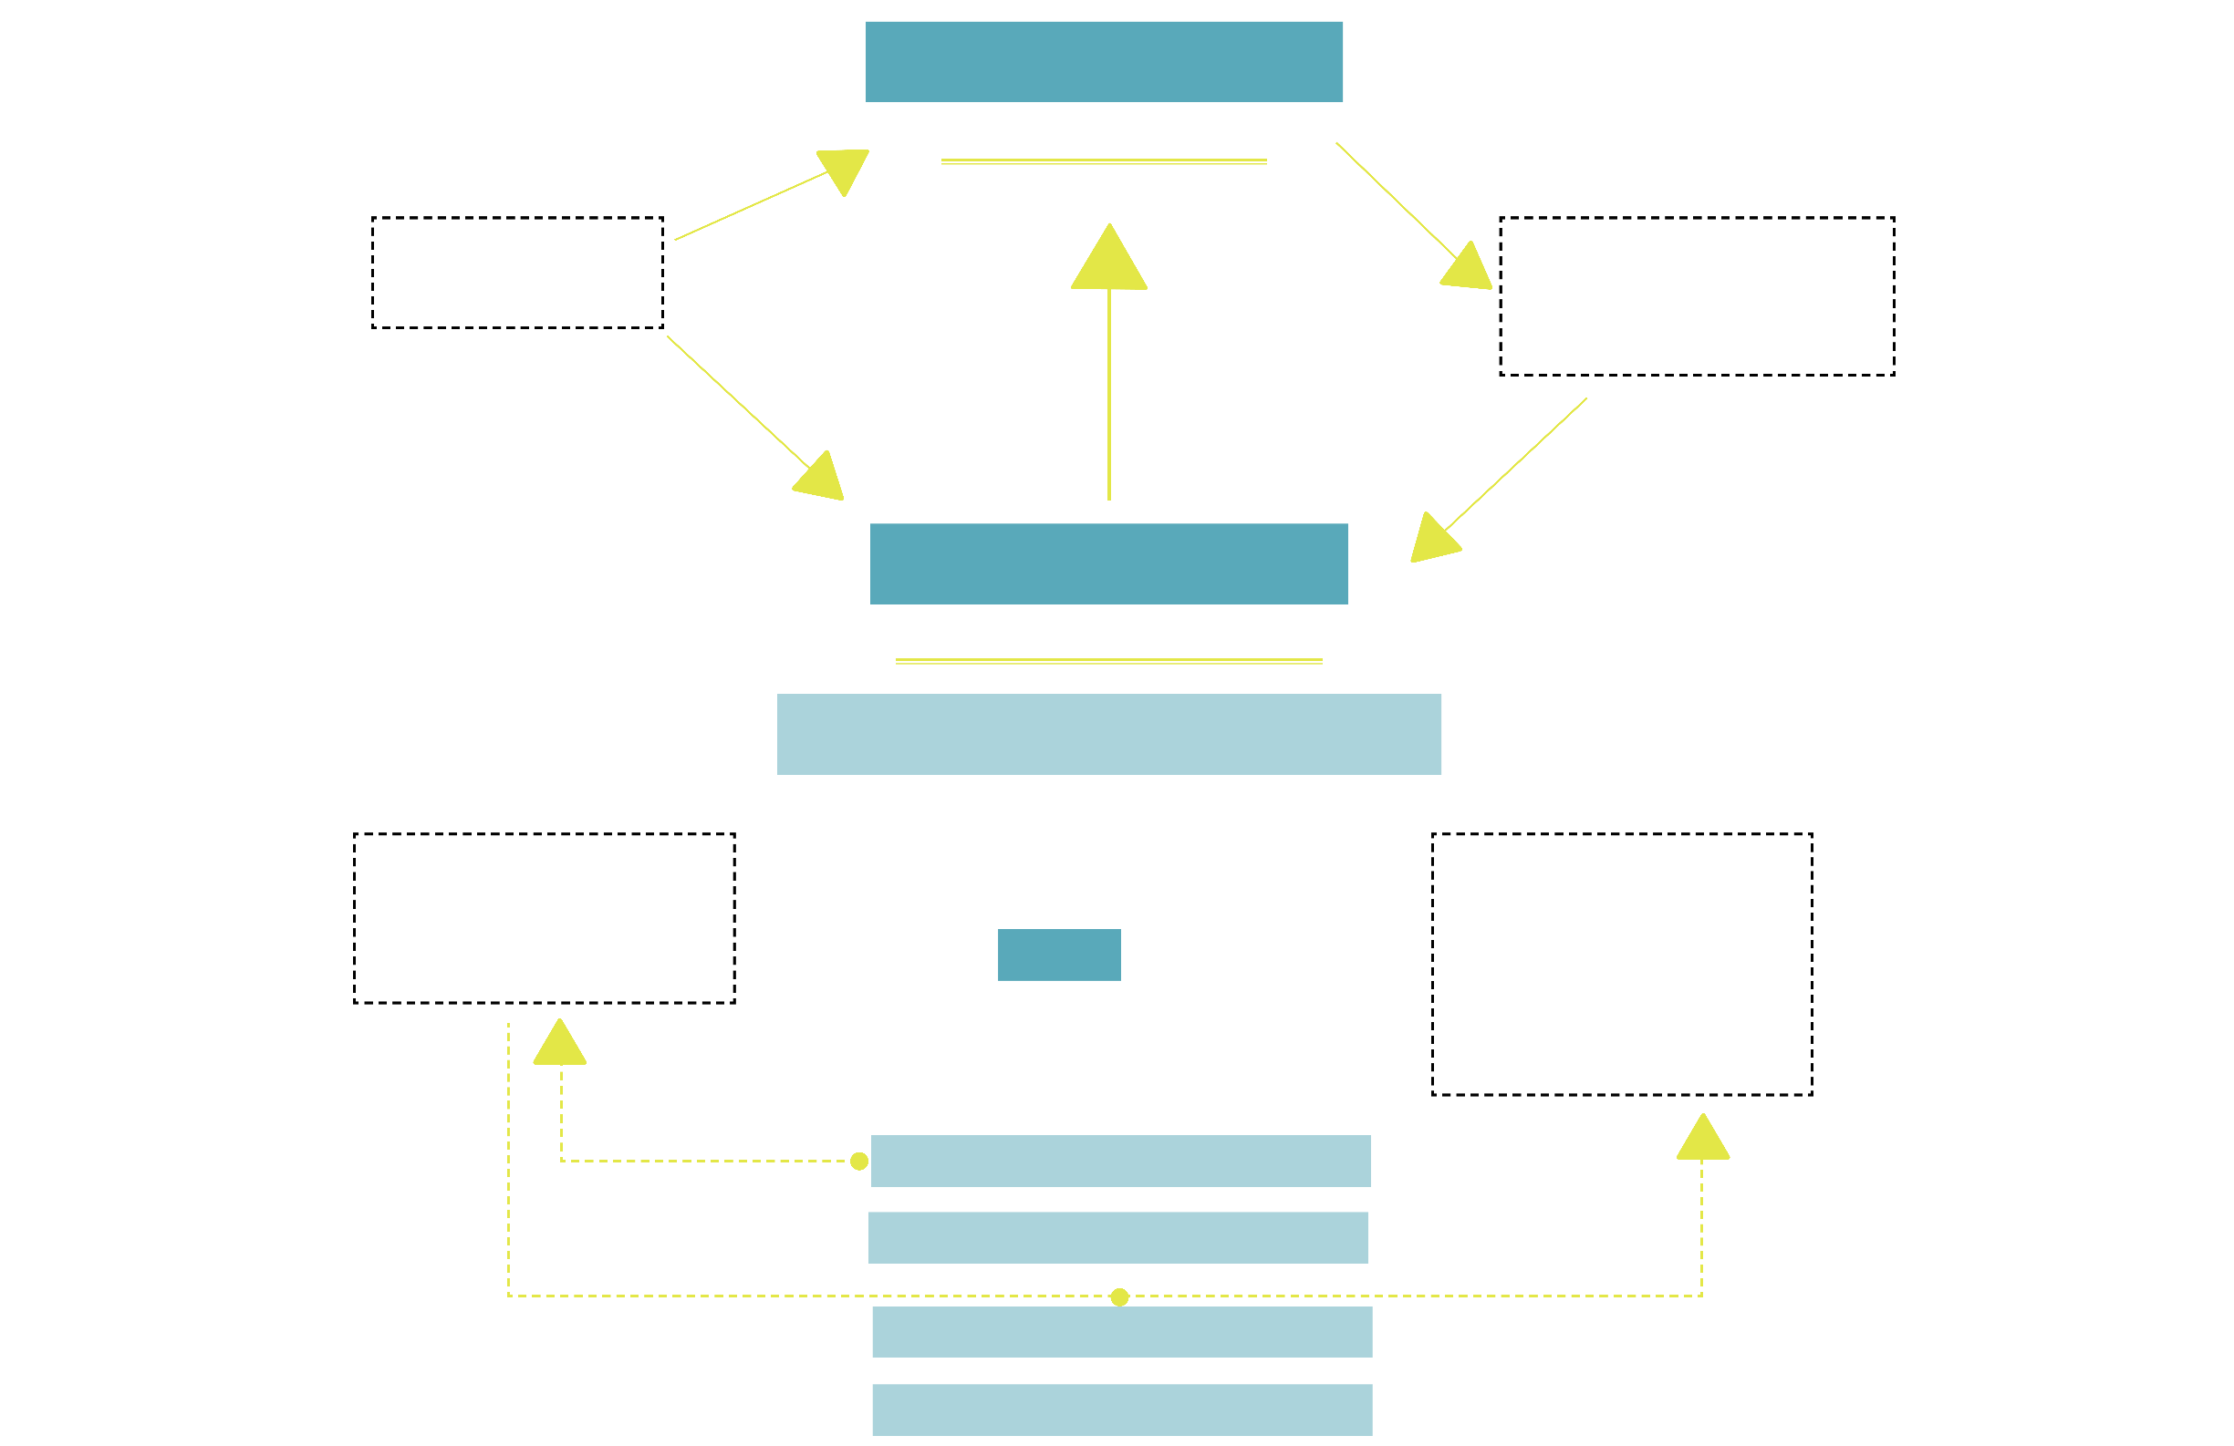
TokenPlay Ecosystem
^{TOKENPLAY WALLET}
^{CREDITED}
^{GAMERS}
^{GAMES}
^{in-game fiat to}
^{TPY conversion}
instant credit to the game developer`s
^{TOKEN PLAY WALLET}
^{instant access}
^{to the exchange}
^{Fiat spent to buy –}
^{sell to TPY}
^{EXCHANGE}
^{TOKENPLAY PLATFORM}
^{BACK-END INFRASTRUCTURE}
^{Games Integration}
^{User Adoption}
^{- through the platform}
^{- through their game}
^{- tournaments}
^{- mobile games}
^{- interactive games}
^{- RPG}
^{- strategy}
^{TPY}
^{token}
^{DEVELOPER SDK}
^{API MARKETPLACE}
^{TOKENPLAY PLATFORM}
^{ERC 20 DEVELOPMENT}

Slide 24
TokenPlay Potential & Blockchain Use Cases
TokenPlay - Built on ERC 20
Use Cases – ICOs
Etherium-2014- $18,439,086
Blockchain technology – LATEST TECH ON THE MARKET
Bancor Protocol – June 2017 – $152,000,000
Token on ERC20
Banking Services (TECH IN DEVELOPMENT)
Aeternity – June 2017 – $62,500,000
Token on ERC20
Blockhain protocol (TECH IN DEVELOPMENT)
EOS – June 2017 – $185,000,000
Token on ERC20
Blockchain Protocol (TECH IN DEVELOPMENT)
Polkadot – October 2017 – $150,000,000
Token on ERC20
Multiblockchain Protocol (TECH IN DEVELOPMENT)
Tezos – July 2017 – $232,000,000
Token on ERC20
Latest Blockchain Technology (TECH IN DEVELOPMENT)
Filecoin – September 2017 – $257,000,000
Token on ERC20
Data storage via blockchain (TECH IN DEVELOPMENT)
Ecosystem
Gaming Industry
Payment Platform
Services
Marketplace
SDK
In-app payment
In-app Conversion
Exchange Platform
Differentiator
Low Fees
Easy Integration
Streamlined Conversion
Potential
$90B Gaming Industry
Lack of a Blockchain Solution
Early Stage – Potential for early Entrants
Technology
ERC 20
Etherium
USE CASES
Efficiency
Reliability

Slide 25
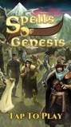
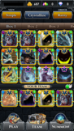
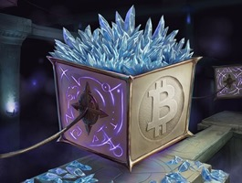
Blockchain Game Example: Spells of Genesis
The game integrates the bitcoin blockchain technology in both its game economy and its storyline.
It uses BitCrystals as its premium currency, which can be easily traded on external cryptocurrency exchanges such as ShapeShift or Bittrex.
BitCrystals
BitCrystals (BCY) is the fuel of the game and its premium currency.
initially issued in a limited supply of 100 000 000
70% offered for sale during the BitCrystals Token Sale in 2015, thus supporting the development of the game
can be traded on the blockchain or used to purchase blockchain-based cards
can be freely traded on different platforms, such as ShapeShift or Bittrex
exchange rate can be followed on CoinCap.
Counterparty Compatible Wallet
If you want to acquire blockchain-based cards and use them in game, you will need to set up a compatible counterparty wallet and connect it to your game account. There are several different types of wallets.
The developer also proposes its own wallet developed specifically for the game.

Slide 26
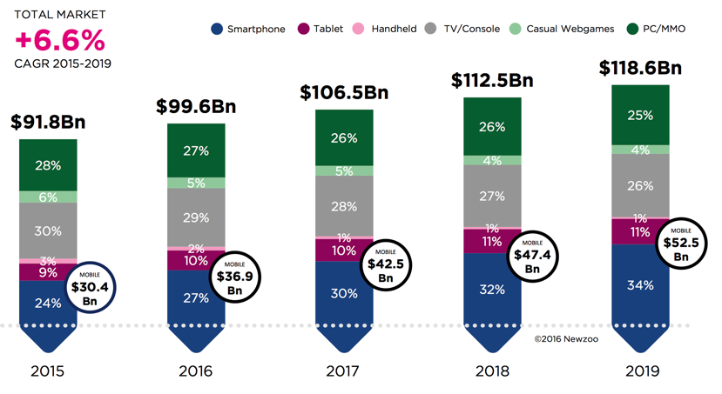
Sales Projections – Global Gaming Market

